Slide 1
How Do We Set Blood Lead Standards?
Deborah A. Cory-Slechta
Professor of Environmental Medicine,
Pediatrics and Public Health Sciences
University of Rochester Medical School

Slide 2
History: Update From 2005
A 2005 ACCLPP Work Group evaluated extant evidence and recommended not changing the level of concern for reasons that included:
    Data available on IQ in association with BLLs <10 µg/dl at that time relied on fewer than 200 children
    The absence of effective clinical or public health interventions that could reliably and consistently lower BLLS that were already <10 µg/dl
    Poor housing, poverty, lead exposure and cognitive impairment often occur together making it difficult to isolate the role of any specific component with certainty
    Uncertainties related to laboratory testing precision
  In 2010 a subcommittee of the ACCLPP met to consider data reported since that time relevant to BLLs <10 µg/dl

Slide 3
Summary of 2012 ACCLPP Work Group Recommendations
Elimination of the use of the phrase ‘level of concern’
No BLL without deleterious effects have been identified in children
Re-emphasize primary prevention
Use of a 5 ug/dl ‘reference value’ for remediation programs
Recognize that a biological ‘threshold’ or ‘effect level’ is not synonymous with a BLL at which intervention is required or effective:
  i.e., separate the science from what to do with respect to medical management, community intervention

Slide 4
2012 Work Group Scientific Rationale
Scientific Rationale intended to be:
  Consideration of the collective weight of the evidence now available related to BLLs<10 µg/dl
  Brief summary of new aspects of the scientific literature reported since the prior document (2005), as considered by the Work Group in its deliberations as related to:
      Reductions in IQ
      Reductions in academic achievement
      Impairments of specific cognitive functions
      Adverse effects on Other Organs/Systems, e.g.,
        Cardiovascular
        Development of reproductive systems
        Growth
        Supportive Animal Evidence

Slide 5
Considerations Leading to Work Group Recommendations
Weight of the Evidence is Critical
    Not all studies are of equal merit, not for Pb or any other epidemiological pursuit.
    Prospective studies, e.g., are considered stronger.
    Cross sectional studies are limited by lack of full history of exposure, but
    Even with that, children’s BLLs are highly correlated over time
    However, critical in such deliberations is the overall weight of the evidence, not the findings from a single study
Shape of the curve below 10 µg/dl is irrelevant
    i.e., greater effects at BLLs <10 µg/dl as compared to >10 µg/dl are not reported for all outcomes and were not a component of the discussion

Slide 6
Additional Considerations Leading to ACCLPP Recommendations
Critical impact of concurrent blood Pb
    It is now clear that concurrent blood Pb is among the strongest predictors of many negative associations and more consistent for many outcomes than maternal or neonatal exposure metrics
Coupled with the fact that there is no evidence to date that effects, once they have occurred, can be reversed
    TLC trial
    Toxicokinetics

Slide 7
Evidence Related to Reductions in IQ at BLLs <10 µg/dl
From populations in North America, Australia, Europe and Asia
Range of IQ tests
Summary/Meta-analyses
  Lanphear et al., 2005 pooled analyses
      Includes 1,333 children from 7 international population-based longitudinal cohort studies

Slide 8
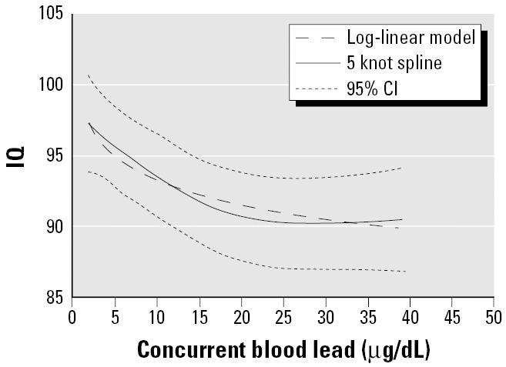
International Pooled Analysis and Blood Lead Levels <10 µg/dl

Slide 9
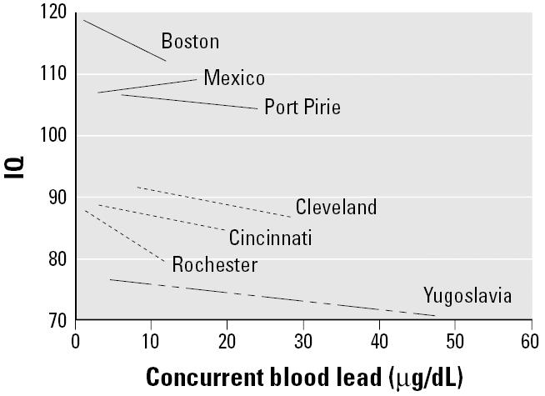
International Pooled Analysis and Blood Lead Levels <10 µg/dl

Slide 10
Evidence Related to Reductions in IQ at BLLs <10 µg/dl
  Additional studies since the last review, e.g.,
      Chen et al., 2005
      Chiodo et al., 2007
      Kim et al., 2009
      Jedrychowski et al., 2009a, 2009b
      Luchinni et al., 2012

Slide 11
Evidence Related to Reductions in IQ at BLLs <10 µg/dl
GENDER SPECIFIC DIFFERENCES IN NEURODEVELOPMENTAL EFFECTS OF PRENATAL EXPOSURE TO VERY LOW-LEAD LEVELS: THE PROSPECTIVE COHORT STUDY IN THREE-YEAR OLDS
W. Jedrychowski et al., Early Human Dev. 2009, 85: 503-510
At 36 months, adjusted estimates of MDI deficit in boys at 36 months confirmed very strong negative impact of prenatal lead exposure (BLL>1.67μg/dL) compared with the lowest quartile of exposure (beta coeff. = −6.2, p = 0.002), but the effect in girls was insignificant (beta coeff = −0.74, p = 0.720).

Slide 12
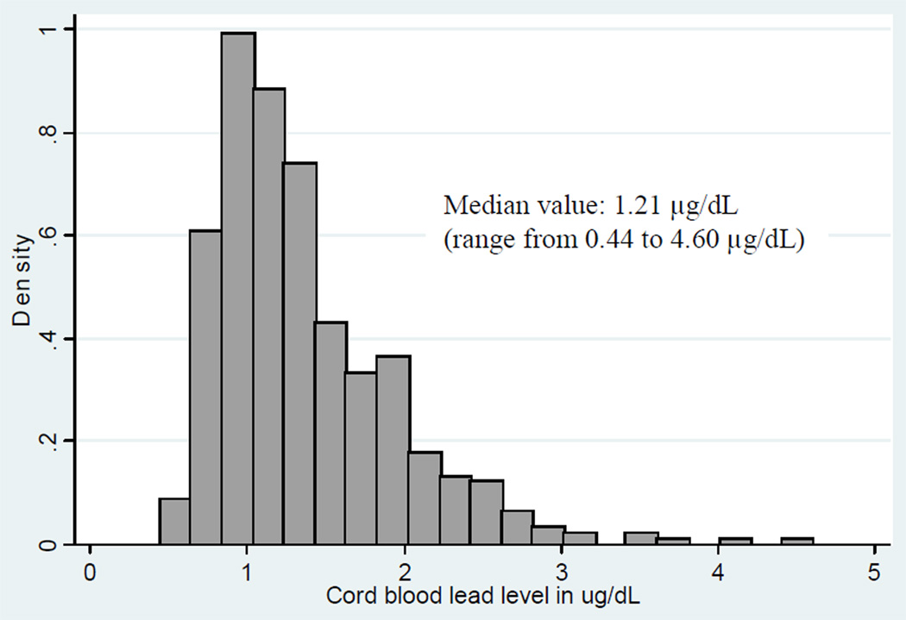
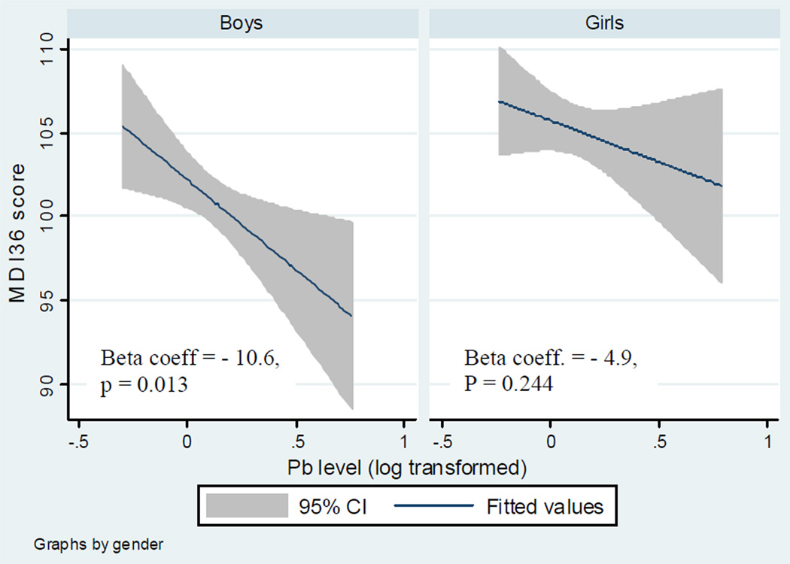
Evidence Related to Reductions in IQ at BLLs <10 µg/dl

Slide 13
Evidence Related to Reductions in IQ at BLLs <10 µg/dl
Conclusion: The study suggests that there might be no threshold for lead toxicity in children and provides evidence that 3-year old boys are more susceptible than girls to prenatal very low lead exposure. The results of the study should persuade policy makers to consider gender-related susceptibility to lead and possibly to other toxic hazards in setting environmental protection guidelines.

Slide 14
Evidence Related to Reductions in IQ at BLLs <10 µg/dl
INVERSE ASSOCIATION OF INTELLECTUAL FUNCTION WITH VERY LOW BLOOD LEAD BUT NOT WITH MANGANESE EXPOSURE IN ITALIAN ADOLESCENTS
R. G. Lucchini, Environmental Research, 2012, 118: 65-71
299 adolescents (49.2% females) aged 11–14 years.
Blood lead (BPb) averaged 1.71 mg/dL
Average total IQ was 106.3
A multiple regression model considering the effect of other covariates, a reduction of about 2.4 IQ points resulted from a two-fold increase of BPb.
The Benchmark Level of BPb associated with a loss of 1 IQ- point (BML01) was 0.19 mg/dL, with a lower 95% confidence limit (BMLL01) of 0.11 mg/dL.

Slide 15
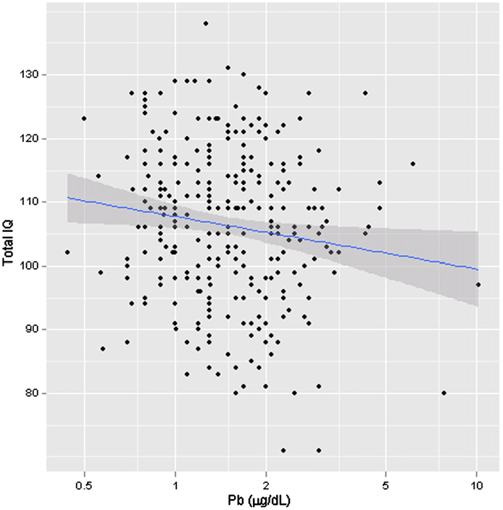
Evidence Related to Reductions in IQ at BLLs <10 µg/dl

Slide 16
Evidence Related to Reductions in IQ at BLLs <10 µg/dl
Importance of concurrent BLLs:
  Most prospective studies show stronger associations between concurrent BLLs and IQ reduction at school age, even though the average BLL at that age is lower.
  Thus, since 2003, data from a much larger and more diverse group of children informs effect levels.
  The NTP monograph on Low Level Lead Toxicity cites sufficient evidence of an association of concurrent BLL with IQ reduction and only limited evidence for prenatal BLL.

Slide 17
Evidence Related to Reductions in Academic Achievement
Negative associations between BLLs and scores in tests of academic performance, class rank, or end of grade testing have been reported in multiple prospective and cross sectional studies in children
  At BLLs from 2 to 10 µg/dl
  From populations in North America, Europe and Africa, e.g.:
    Surkan et al., 2007
    Al-Saleh et al., 2001
    Wang et al., 2002
    Min et al., 2009
    Chandramouli et al., 2009

Slide 18
Evidence Related to Reductions in Academic Achievement
COGNITIVE DEVELOPMENT AND LOW-LEVEL LEAD EXPOSURE IN POLY-DRUG EXPOSED CHILDREN
M. O. Min et al., Neurotoxicology and Teratology, 2009, 31: 225-231
Postnatal lead exposure at 4 yr on children's IQ and academic achievement at 11 years of age
278 inner-city, primarily African American children
Decrements in scores on tests of non-verbal reasoning were consistently associated with higher lead levels at age 4, while verbal decrements became apparent only at age 11.
Lower reading summary scores at 9 and 11 years were consistently associated with higher lead exposure, while decrements in mathematics were not apparent until 11 years.
Subgroup analyses on children with blood lead levels <10 μg/dL showed detrimental lead effects even at the 5 μg/dL level, providing additional evidence of adverse effects occurring at blood lead levels below the current 10 μg/dL public health blood lead action level.

Slide 19
Evidence Related to Reductions in Academic Achievement
Chandramouli et al., Effects of early childhood lead exposure on academic performance and behaviour of school age children. Arch. Dis Child, 2015, 94: 844-848
Methods: Venous samples at 30 months of age (n=582), and developmental, behavioural and standardised educational outcomes (Standard Assessment Tests, SATs) at 7–8.
Results: blood lead levels showed significant associations with reading, writing and spelling grades on SATs, and antisocial behaviour. A doubling in lead concentration was associated with a 0.3 point (95% CI 20.5 to 20.1) decline in SATs grades.
No effects on outcomes were apparent at 2–5 mg/dl, but levels of 5–10 mg/dl were associated with a reduction in scores for reading (OR 0.51, p=0.006) and writing (OR 0.49, p=0.003).
Lead levels <10 mg/dl were also associated with increased scores for antisocial behaviour (OR 2.9, p=0.040) and hyperactivity (OR 2.82, p=0.034).

Slide 20
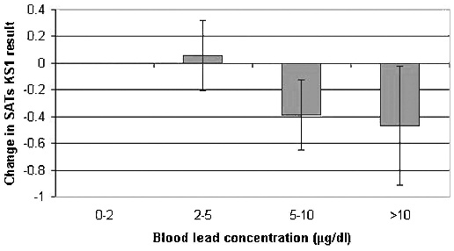
Evidence Related to Reductions in Academic Achievement
Chandramouli et al., Effects of early childhood lead exposure on academic performance and behaviour of school age children. Arch. Dis Child, 2015, 94: 844-848
Conclusions: Exposure to lead early in childhood has effects on subsequent educational attainment, even at blood levels below 10 mg/dl. These data suggest that the threshold for clinical concern should be reduced to 5 mg/dl.

Slide 21
Evidence Related to Impairments in Specific Cognitive Functions
Demonstrated in general and specific measures of cognitive function in prospective and cross-sectional studies of children from 3 mos to 16 yrs, from multiple different populations, e.g.:
  Multiple studies report impaired attention-related behaviors at mean BLLs <5 µg/dl
    More than 10 publications since 2000 report an association between current BLLs at mean values of 1-11 µg/dl and diagnosis of ADHD or decreased attention, hyperactivity in children 3-18 yrs of age

Slide 22
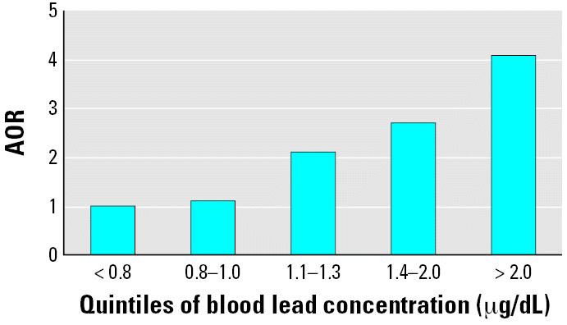
Evidence Related to Impairments in Specific Cognitive Functions: Attention
Braun et al., 2006, Environmental Health Perspectives 114: 1904-1909

Slide 23
Evidence Related to Impairments in Specific Cognitive Functions: Attention
Case-control study of 1260 children: Only 10.1% of non-ADHD children had BLLs > 10 μg/dL, whereas this percentage increased significantly to 24.4% in ADHD children. (χ2 = 237, p < 0.01). In addition, 49.8% of non-ADHD children had BLLs > 5 μg/dL, whereas of the ADHD cases, 74.7% had BLLS > 5 μg/dL (χ2 = 116, p < 0.01).
Wang et al., 2008, Environmental Health Perspectives 116: 1401-1406

Slide 24
Evidence Related to Impairments in Specific Cognitive Functions: Attention
Table 3.
Raw correlations between questionnaire-based ADHD-variables and trace metal-concentrations in blood. Mean concurrent blood lead = 3-5 ug/dl
ADHD-Variable Parents Teachers
Al Pb Hg Al Pb Hg
Inattention −0.11 0.32⁎⁎ −0.02 −0.01 0.26⁎ −0.00
Hyperactivity −0.08 0.30⁎⁎ −0.02 −0.05 0.12 0.02
Impulsivity −0.06 0.33⁎⁎ −0.02 −0.03 0.15 0.10
ADHD-total −0.10 0.33⁎⁎ −0.02 −0.03 0.22⁎ 0.03
⁎ p<0.05. ⁎⁎ p<0.01.
Nicolescu et al., 2010, Environmental Research 110: 476-483

Slide 25
Evidence Related to Impairments in Specific Cognitive Functions: Attention
BLOOD LEAD LEVELS AND SPECIFIC ATTENTION EFFECTS IN YOUNG CHILDREN
Chiodo et al., 2007, Neurotoxicology and Teratology, 29: 538-546
The results of the present study show a relation between blood lead level and neurobehavioral outcome in 7-year-old children (N = 506).
Higher lead levels were associated significantly with decreased scores on measures of intelligence (i.e., overall, performance and verbal IQ), lengthened reaction time, hyperactivity, and social and delinquent behavior problems.
Importantly, the present study documents a significant negative impact of blood lead levels on attention, but not impulsivity, in early elementary age children
Visual inspection of non-parametric regression plots suggested a gradual linear dose–response relationship for each endpoint. None of the neurobehavioral outcomes assessed showed evidence of a threshold under which lead levels appear to “safe”.

Slide 26
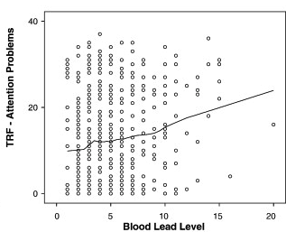
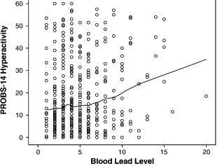
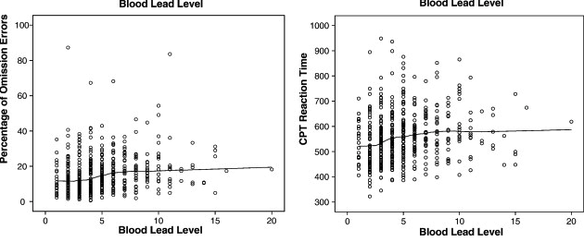
Evidence Related to Impairments in Specific Cognitive Functions: Attention

Slide 27
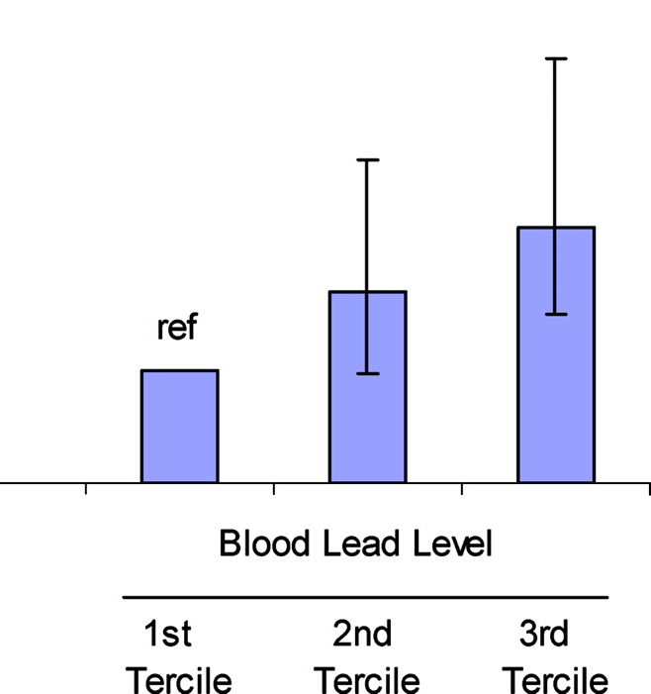
Evidence Related to Impairments in Specific Cognitive Functions: Attention
Adjusted Odds Ratio for ADHD
When the sample was restricted to children with lead concentrations of ≤5 μg/dL,
increasing lead levels were still significantly associated with DSM-IV–defined ADHD;
compared with children in the lowest tertile (non-detectable to 0.8 μg/dL), those with
lead levels in the highest tertile (>1.3–5 μg/dL) had a more than twofold increased
risk of ADHD (aOR for third versus first tertile: 2.3 [95% CI: 1.4–3.7]).
Froelich et al., 2009, Pediatrics 124: e1054-e1063

Slide 28
Evidence Related to Adverse Effects on Other Organs/Systems
BLLs <10 µg/dl in children are associated with delayed puberty onset in children aged 8-17 as reported in 8 cross-sectional studies and one prospective study from 7 different populations in North America, Europe and Africa and adjusted for factors known to influence puberty including race, BMI and SES
BLLs <10 µg/dl in children are associated with stunted postnatal growth including reports from prospective studies of negative associations between maternal BLL <10 µg/dl and head circumference; growth retardation supported by multiple cross-sectional studies and findings from the three relevant prospective studies
Cord BLLs (mean 3 µg/dl) in a prospective study associated with blood pressure changes at 9.5 yrs of age, and early childhood BLL (mean 4.6 µg/dl) associated with increased blood pressure in response to acute stress, findings highly consistent with animal studies

Slide 29
Evidence Related to Adverse Effects on Other Organs/Systems: Reproductive/Developmental
Chapaevsk, Russia
Boys 11-12; n=481 – Prospective- Delayed puberty onset in boys with blood Pb ≥5 μg/dL. Williams (2010)
Boys 8-9; n=489 -Cross-sectional- Delayed puberty onset in boys with blood Pb ≥5 μg/dL. Hauser (2008)
NHANES III
Girls 8-16; n=1,235- Cross-sectional - Delayed puberty onset in girls with blood Pb ≥2 μg/dL compared to those with blood Pb <2 μg/dL. Wu (2003).
Girls 8-11; n=705- Cross-sectional- Girls with higher blood Pb (≥5 μg/dL compared to <1 μg/dL) had lower likelihood of having inhibin B levels >35 pg/mLs. Gollenberg (2010)
Girls 8-16; n=600-805 - Cross-sectional- Delayed puberty onset in African American and Mexican American girls at blood Pb >3 μg/dL compared to <1 μg/dL; not in non-Hispanic whites. Selevan (2003)
Girls 13 years; n=682- 712 - Cross-sectional - Delayed puberty onset at blood Pb ≥5 μg/dL, and significant association with blood Pb by trend analysis across for stage or age at menarche. Naicker (2010)
Children aged 17 n=100 Pb and 100 referent-Cross-sectional -Testicular volume was lower in boys living in areas with higher blood Pb (1.8- 2.7 μg/dL) compared to referents (1.5 μg/dL). Staessen (2001)
Girls aged 10-17; n=138 -Cross-sectional- delayed puberty onset (age at menarche) in girls with blood Pb above mean (≥0.49 μg/dL) and a predicted delay in age at menarche of 10 months with blood Pb >median (1.2 μg/dL). Denham (2005)
Girls 9 years; n=139 -Cross-sectional -Blood Pb had no effect on puberty onset in girls (by breast and pubic hair stage) with median blood Pb level of 2 μg/dL. Wolff (2008)
Modified from NTP Monograph

Slide 30
Evidence Related to Adverse Effects on Other Organs/Systems: Postnatal Growth
Cincinnati Pb Study
Children 15 mos; n= 260 – Prospective- Concurrent blood Pb (>3.4 μg/dL) in children was inversely associated with growth rate (length) at 15 mos in children of mothers with Pb >7.7 μg/dL. Shukla (1989)
Children ≤33 mos; n=235 – Prospective - Current blood Pb was inversely associated with length at 33 mos in children with higher blood Pb (>10.8 μg/dL) from 3 to 15 months of age. Shukla (1991)
Albany Pregnancy Infancy Pb Study
Children 0.5-1 yr; n=211 – Prospective - Maternal blood Pb (≥3 μg/dL) was inversely associated with infant head circumference at 6 and 12 months, but not with length or weight. Schell (2009)
Cleveland Pb Study
Children <5; n= 151-185 – Prospective - Blood Pb at 6 mos (10 μg/dL) was related to subsequent head circumference (p=0.05) and marginally related to subsequent length (p=0.06) and weight (p=0.08); blood Pb at 1-4 years old was not related to weight, length, head circumference at 4 years old. Greene (1991)
Mexico City Prospective Study
Children 0.5-1; n=50-111 – Prospective - Maternal blood Pb at 36 weeks (median, <10 μg/dL) was inversely associated with infant head circumference at 6 and 18 months. Infant blood Pb (1 year) was inversely associated with head circumference at 36 months. Rothenberg (1993)
Children 0.5-4; n =119-199 – Prospective- Maternal (36 weeks) and infant (1 year) blood Pb (median, <10 μg/dL) were inversely associated with infant head circumference up to 4 years. Rothenberg (1999)
Modified from NTP Monograph

Slide 31
Evidence Related to Adverse Effects on Other Organs/Systems: Postnatal Growth
Yugoslavia Prospective Study
Children birth, 1, 4, 6, and 10 years; n=309- Prospective- Maternal blood Pb was not correlated to height or weight in children from 1 to 10 years of age. Lamb (2008)
Children 4 yrs; n=156-175 - Cross-sectional - Concurrent blood Pb (<15 μg/dL) was inversely associated with height in Pristina, but blood Pb (20-40 μg/dL) was not related to height in Titova-Mitrovica, a Pb smelter town. Factor-Litvak (1999)
NHANES III
Children 1-7; n=4,391 - Cross-sectional - Concurrent blood Pb (mean, 3.6 μg/dL) was inversely associated with height and head circumference but not with weight. Ballew (1999)
Girls 8-16; n=600-805 - Cross-sectional - Concurrent blood Pb ≥3 μg/dL was associated with decreased height compared to iblood Pb of 1 μg/dL but not with weight. Selevan (2003)
NHANES II
Children 0.5-7 yrs; n=2695 - Cross-sectional - Concurrent blood Pb (range, 5-35 μg/dL) was inversely associated with height, weight, and chest circumference. Schwartz (1986)
Mexican-Americans 5-12 yr; n=1,454 - Cross-sectional - Concurrent blood Pb (mean: boys, 10.6 μg/dL; girls, 9.3 μg/dL) was inversely associated with height. Frisancho (1991)
Modified from NTP Monograph

Slide 32
Responses to Input Received on the Scientific Rationale
Arguments against concern over residual confounding with low SES
  Boston prospective cohort was described by the authors as a “socioeconomically advantaged population” (Bellinger and Needleman)
  In the Yugoslavia prospective cohort in which an reported inverse association of BLL with IQ was reported, only BLLs, and not SES, differentiated the two towns comprising the cohort. Thus, IQ was reduced only with elevated BLLs in comparison to an SES equivalent population without elevated BLLs.
  Health Canada document: “The pattern of results does not appear to be dependent on cohort demographics, such as SES (socioeconomic status), nor do they appear to be dependent on exposure range – significant associations have been reported among both relatively low and relatively high socioeconomic strata….”

Slide 33
SES Can Enhance Effects of Pb
Lifetime Pb and Stress in Mouse Models
Female
Male
Lifetime Pb and prenatal stress synergistically increase FI response rates in males, with similar, but non-significant trends in females
Cory-Slechta et al., 2012

Slide 34
SES is a MODIFIER of Lead Effects
LEAD NEUROTOXICITY AND SOCIOECONOMIC STATUS: CONCEPTUAL AND ANALYTICAL ISSUES
D. C. Bellinger, Neurotoxicology, 2008, 29: 828-832
Socioeconomic status (SES) is usually considered to be a potential confounder of the association between lead exposure and children’s neurodevelopment, but experimental and epidemiological data suggest that SES might also modify lead neurotoxicity.
Conventional models, which treat SES and SES-related factors solely as potential confounders, do not capture the possibility that a child’s early lead exposure alters the behaviors that the child elicits from others.
On a trans-generational level, low SES might be a proxy for vulnerability to lead. To estimate the burden of lead-associated neurotoxicity on a population level, we need to apply analytical approaches that model a child’s development and its context as a complex system of interdependent relationships that change over time.

Slide 35
SES is a MODIFIER of Lead Effects
JOINT EXPOSURE TO CHEMICAL AND NONCHEMICAL NEURODEVELOPMENTAL STRESSORS IN U.S. WOMEN OF REPRODUCTIVE AGE IN NHANES
Amanda M. Evans et al., Int. J. Environ. Res. Public Health 2014, 11 4385
We characterized exposure to Pb, MeHg and a measure of physiological dysregulation associated with chronic stress and examined race/ethnicity as a predictor of joint NDT exposure.
Using data from the 2003−2004 NHANES, potential chronic stress exposure was estimated using allostatic load (AL), a quantitative measure of physiological dysregulation.
Logistic regression was used to assess the relationship between an indicator of elevated joint NDT exposures (HINDT > 1) and race/ethnicity. The multivariate model was stratified by AL groups to examine effect measure modification.
African American (adjusted odds ratio [OR] [95% confidence interval] = 2.2 [1.4, 3.3]) and Mexican American (1.4 [0.7, 2.6]) women were more likely to have an HINDT > 1 compared to Caucasian women.
Chronic stress was identified as an effect measure modifier with the largest ORs among women with high AL scores (African Americans = 4.3 [2.0, 9.5]; Mexican Americans = 4.2 [1.3, 14.1]).
Chronic stress was found to modify the association between elevated joint NDT exposure and race/ethnicity, highlighting the importance of evaluating chemical and nonchemical stressor exposures leading to a common endpoint.

Slide 36
Responses to Input Received on the Scientific Rationale
Despite reductions in BLLs, reading and math scores have not increased
Even though BLLs have declined, ADHD diagnoses have risen:
  BOTH ARE MULTIFACTORIAL OUTCOMES AND NOT DEPENDENT UPON CHANGES IN BLLs ALONE
  No published studies could be identified to support this
  IQ scores, math scores and US reading scores have actually increased

Slide 37
Greater Magnitude Effects at Lower BLLs
Argument that in a lower lead environment, the same differences in developmental outcome are now associated with small differences in BLL, magnifying the apparent effect of each µg/dl BLL on various developmental outcomes:
  But this is not the sole determinant in the context of the weight of the evidence and does not provide evidence of no effects below 10 µg/dl
  Does not explain effects of BLLs < 10 µg/dl on other outcomes and organs/systems where they have not been reported

Slide 38
Multiplicity of Lead Effects
One proposed insertion states that “…the lack of specificity implied by multiple endpoints suggest the need for more study of these outcomes.”
  The biology of Pb is completely consistent with an impact on multiple organs/systems and thus multiple endpoints.
  Pb is a calcium mimetic, and in some studies Pb has been shown to be used preferentially by the body over calcium.
  Calcium is the most important metal in the body from a physiological perspective, being used in a wide variety of cellular processes that generalize across organs (e.g., basic neurotransmission as per the CNS and PNS).
  Pb also substitutes for other essential metals in the body including zinc, copper and iron.

Slide 39
Summary of the Bases for the Work Group Recommendation
Many of the uncertainties associated with BLLs <10 μg/dl have been minimized or eliminated by research published since the health effects review undertaken by the 2005 Work Group.
The weight of evidence supports associations of BLLs <10 μg/dl with a variety of endpoints in children, including reductions in IQ and in academic achievement, impairments in attention-related behaviors, and less extensive, but supporting evidence of retardation of growth and delayed puberty.
The weight of evidence also underscores the importance of concurrent exposure of children in many of these outcomes.
If there isn’t sufficient weight of evidence across these studies, its time to retire epidemiological approaches

Slide 40
Emphasizing Primary Prevention
Currently, children serve as the proverbial ‘canaries in the coal mine’ in that elevated BLL is used to identify Pb sources
Current strategy of identifying elevated BLLs does not prevent damage already incurred
Economic analyses of reducing or eliminating lead always have a positive $ benefit.

